Slide 1

Item 17: Understand special member function generation
Scott Meyers - Effective Modern C++
Presented By
@7eRoM

Slide 2
Default Constructor
If a class does not have any constructor defined, the compiler generates a default constructor
It initializes the object's member variables to their default values.
The default constructor is invoked when an object is created without any arguments.
Destructor
If the programmer does not define a destructor, the compiler generates a default destructor.

Slide 3
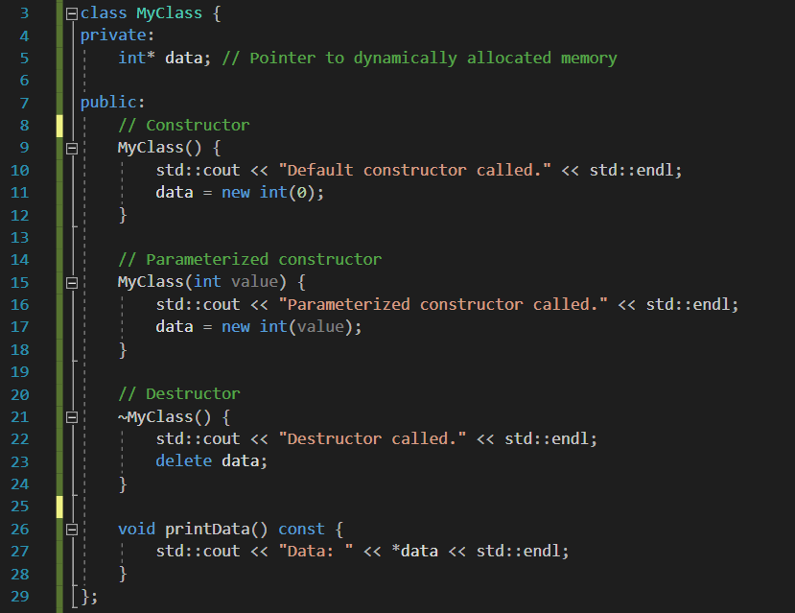
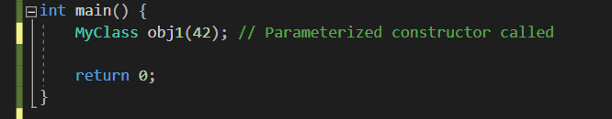

Slide 4
Copy Constructor
The copy constructor creates a new object by making a copy of an existing object.
It is called when an object is initialized with another object of the same class.
Copy Assignment Operator
The copy assignment operator is used to assign the values of one object to another object of the same class.
It is invoked when the assignment operator (=) is used between two objects.

Slide 5
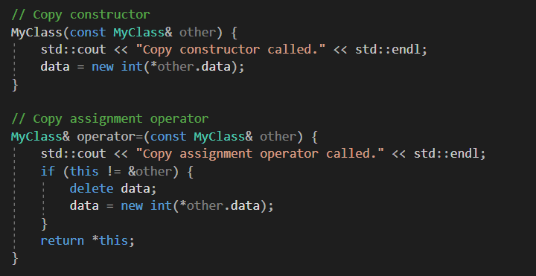
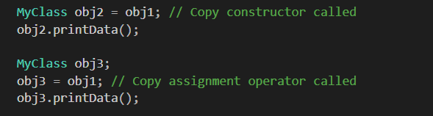

Slide 6
Move Constructor
Introduced in C++11, the move constructor is used to efficiently transfer the resources (such as dynamically allocated memory) from one object to another.
It is invoked when an object is initialized with an rvalue (such as a temporary object).
Move Assignment Operator
Introduced in C++11, the move assignment operator is used to efficiently transfer the resources from one object to another object of the same class.
It is invoked when the move assignment operator (=) is used between two objects.

Slide 7
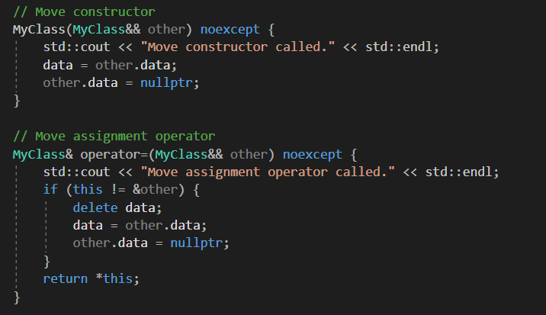
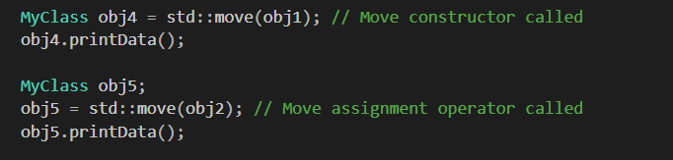

Slide 8
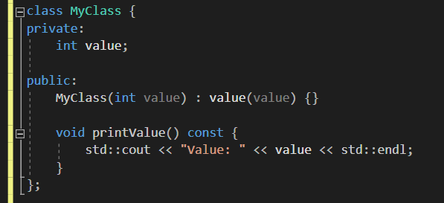
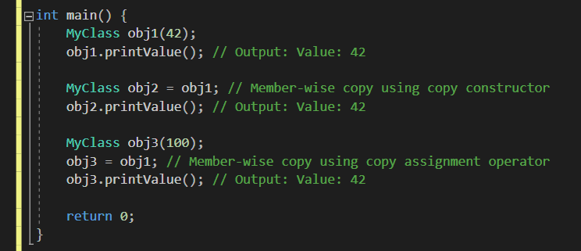
member-wise copy refers to the process of copying the values of each member variable from one object to another object of the same class.
This copy is typically performed using the assignment operator (=) or the copy constructor of the member variable's type.

Slide 9
C++98 has four special member functions:
the default constructor
the destructor
the copy constructor
the copy assignment operator
As of C++11, the special member functions club has two more inductees:
the move constructor
the move assignment operator
memberwise moves on the non-static data members of the class.
“Memberwise moves” are, in reality, more like memberwise move requests, because types that aren’t move-enabled (e.g., most C++98 legacy classes)
a memberwise move consists of move operations on data members and base classes that support move operations, but a copy operation for those that don’t.

Slide 10
As is the case with the copy operations, the move operations aren’t generated if you declare them yourself.
The two copy operations are independent: declaring one doesn’t prevent compilers from generating the other.
if you declare a copy constructor, but no copy assignment operator, then write code that requires copy assignment, compilers will generate the copy assignment operator for you.
if you declare a copy assignment operator, but no copy constructor, yet your code requires copy construction, compilers will generate the copy constructor for you.
The two move operations are not independent: If you declare either, that prevents compilers from generating the other.
The rationale is that if you declare, say, a move constructor for your class, you’re indicating that there’s something about how move construction should be implemented that’s different from the default memberwise move that compilers would generate.
And if there’s something wrong with memberwise move construction, there’d probably be something wrong with memberwise move assignment, too.

Slide 11
move operations won’t be generated for any class that explicitly declares a copy operation.
declaring a copy operation indicates that the normal approach to copying an object (memberwise copy) isn’t appropriate for the class, and compilers figure that if memberwise copy isn’t appropriate for the copy operations, memberwise move probably isn’t appropriate for the move operations.
Declaring a move operation in a class causes compilers to disable the copy operations (by deleting them).
if memberwise move isn’t the proper way to move an object, there’s no reason to expect that memberwise copy is the proper way to copy it.

Slide 12
Rule of Three: if you declare any of a copy constructor, copy assignment operator, or destructor, you should declare all three.
whatever resource management was being done in one copy operation probably needed to be done in the other copy operation
the class destructor would also be participating in management of the resource (usually releasing it)
A consequence of the Rule of Three is that the presence of a user-declared destructor indicates that simple memberwise copy is unlikely to be appropriate for the copying operations in the class.
if a class declares a destructor, the copy operations probably shouldn’t be automatically generated, because they wouldn’t do the right thing.

Slide 13
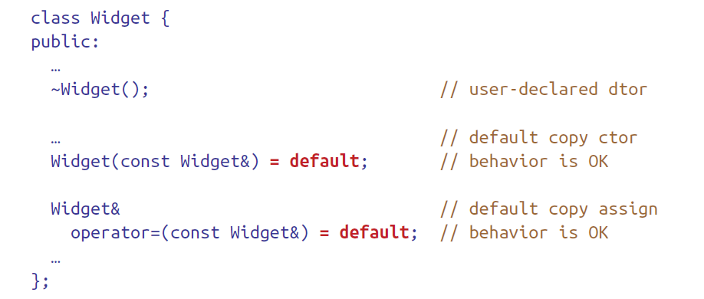
move operations are generated for classes (when needed) only if these three things are true:
No copy operations are declared in the class.
No move operations are declared in the class.
No destructor is declared in the class.
if memberwise copying of the class’s non-static data members is what you want), your job is easy, because C++11’s “= default” lets you say that explicitly

Slide 14
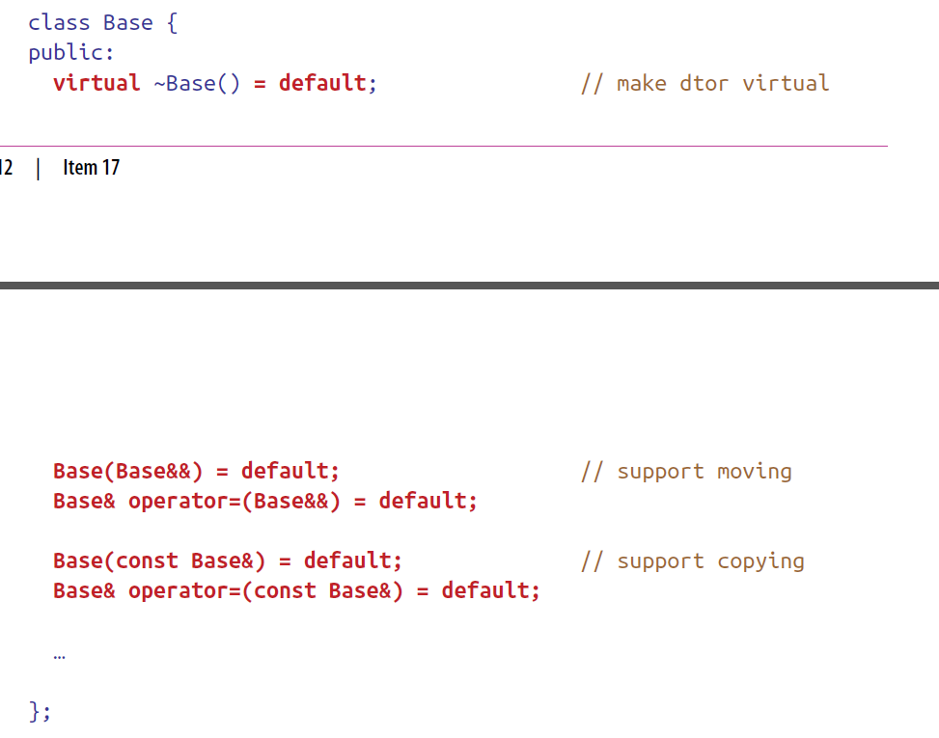
This approach is often useful in polymorphic base classes, i.e., classes defining interfaces through which derived class objects are manipulated.

Slide 15
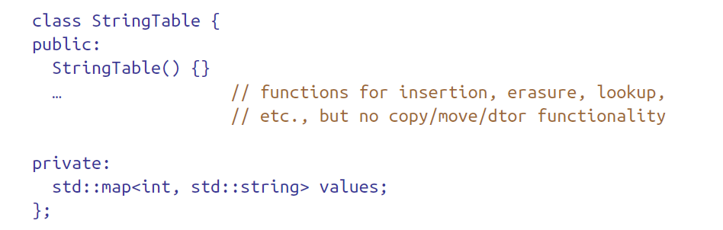
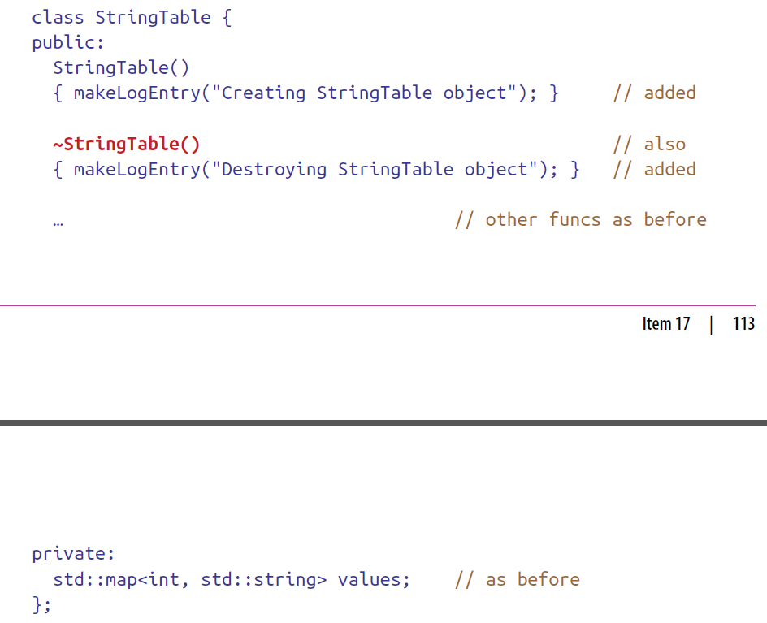
Explicitly declaring and using "= default" for copy and move operations, even when compilers can generate them correctly, provides clearer intentions and helps avoid subtle bugs. As an example:
sometime later, it’s decided that logging the default construction and the destruction:

Slide 16
This looks reasonable, but declaring a destructor has a potentially significant side effect:
it prevents the move operations from being generated.
requests to move cause copies to be made.
copying a std::map<int, std::string> is likely to be orders of magnitude slower than moving it.
Explicitly defining copy and move operations using "= default" would have prevented this issue from occurring.

Slide 17
The C++11 rules governing the special member functions are thus:
Default constructor
Same rules as C++98. Generated only if the class contains no user-declared constructors.
Destructor
Essentially same rules as C++98; sole difference is that destructors are noexcept by default.
As in C++98, virtual only if a base class destructor is virtual.

Slide 18
Copy constructor
Same runtime behavior as C++98: memberwise copy construction of non-static data members.
Generated only if the class lacks a user-declared copy constructor.
Deleted if the class declares a move operation.
Generation of this function in a class with a user-declared copy assignment operator or destructor is deprecated.
Copy assignment operator
Same runtime behavior as C++98: memberwise copy assignment of non-static data members.
Generated only if the class lacks a user-declared copy assignment operator.
Deleted if the class declares a move operation.
Generation of this function in a class with a user-declared copy constructor or destructor is deprecated.

Slide 19
Move constructor and move assignment operator
Each performs memberwise moving of non-static data members.
Generated only if the class contains no user-declared copy operations, move operations, or destructor.

Slide 20
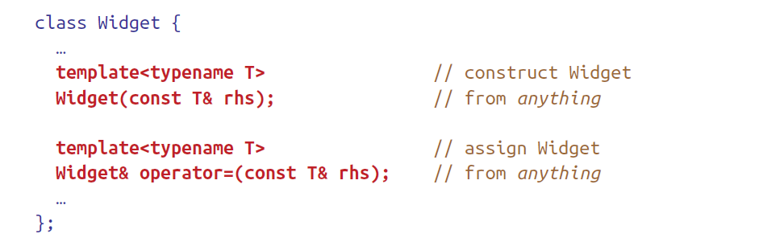
Note that there’s nothing in the rules about the existence of a member function template preventing compilers from generating the special member functions
Compilers will still generate copy and move operations for Widget, even though these templates could be instantiated to produce the signatures for the copy constructor and copy assignment operator (That would be the case when T is Widget.)
It can have significant consequences (Item 26)

Slide 21

I’m cool as a cucumber

